Slide 1
Covid-19 Vaccine Management System
Rohan Agarwal (RA1811003010606)
Sachin Agrawal (RA1811003010609) Yash Rajoria (RA1811003010625)

Slide 2
Introduction
Coronavirus disease 2019 (COVID-19), also known as the coronavirus, or COVID, is a contagious disease caused by severe acute respiratory syndrome coronavirus 2 (SARS-CoV-2).
A system to track the resources is required. This helps us to efficiently utilize them and can save precious lives.
A transparent, robust, and reliable solution ensuring equal distribution of the already scarce resources is essential.
We propose a novel solution with 5 tables, namely- Manufacturer, warehouse, state, medical institute and patient in our database to achieve above functionalities.

Slide 3
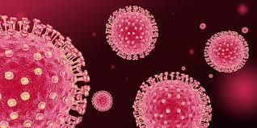
What is Covid-19?
The first known case was identified in Wuhan, China, in December 2019. The disease has since spread worldwide, leading to an ongoing pandemic.

Slide 4
The Problem
A vast population catalyzed by mismanagement of already scarce vaccines is a major concern.
Though the system may be unable to solve the ongoing pandemic, it can surely help to soften its effect.
The current system of state vaccine stores get their supplies either from government medical store depots or directly from manufacturers which is quite confusing.

Slide 5
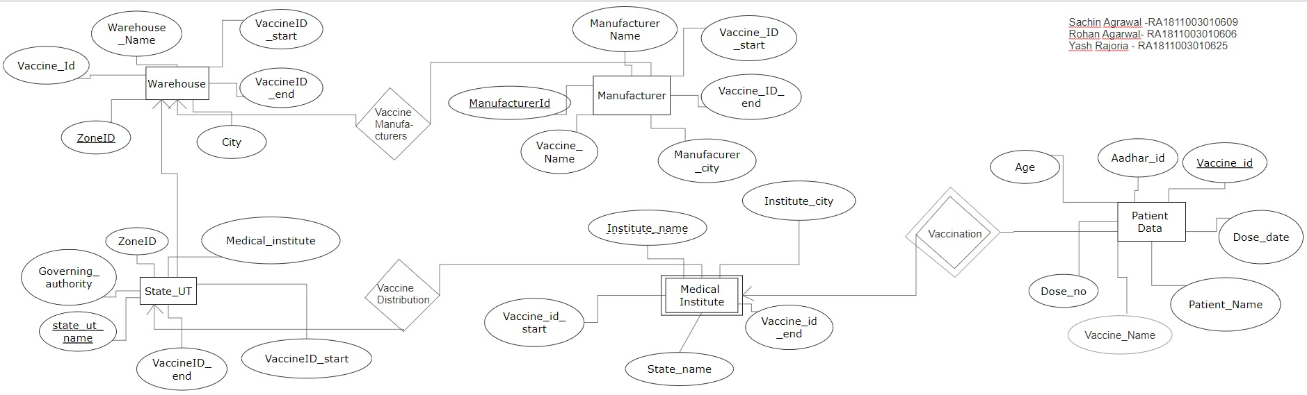
Solution (ER Diagram)-
Notes:
ER diagram representing the structure of the project. The underlined attributes denote primary key while the dashed one is the distinguisher in weak entity. Proper relations like one- many etc also indicated with the use of arrows.

Slide 6
Manufacturer Table
There are various vaccines current circulating around the country. For eg. AstraZenca, CoviShield, Sputnik V and others.
Naturally there are manufacturers in different states for different vaccines.
These manufacturers will be given a manufacturer ID (primary key) to identify them quickly.
Vaccines with the manufacturer will be given a unique number(1,2,3…..).
Attribute vaccine start & vaccine end will be the unique ID of the first and last vaccine produced.
Vaccines will be passed to the respected warehouse.

Slide 7
Warehouse Table
The vaccines received from manufacturer will be stored in a warehouse.
The solution proposed will have 4 warehouses, in each part of India ie. North, South, West, East.
These warehouses will be given a Zone ID (primary key) to identify them quickly.
Attribute vaccine start & vaccine end will be the unique ID of the first and last vaccine received.
Vaccines will then be passed to the respected State/UT.

Slide 8
State/Union Territory Table
The vaccines received from warehouse will be handed to state authorities which will be responsible for distribution to medical institutes in their region.
State/U.T. name will serve as primary key as it is always unique.
Attribute vaccine start & vaccine end will be the unique ID of the first and last vaccine received.
Vaccines will then be passed to the medical institutes.

Slide 9
Medical Institutes and Patient’s Table
Medical Institutes in the end are responsible for administering the vaccines to the patients.
The medical institutes have to save the patient details in Patient’s table like Aadhar Card, Patient’s name, Address etc.
Dose number stating that which jab is being administered.
This table does not contains a primary key and has a distinguisher and so it is a weak entity.

Slide 10
Conclusion
Covid-19 has reminded the need of a centralized and proper management system in-order to efficiently utilize the resources available.
A transparent system divided into stages of- Manufacturer, warehouse, state authority, medical institute and patient tables provides a neat, transparent and easy to track system where the whole data can be queried with minimum effort.
The use of concepts like single-row functions, triggers etc. provide an interface for analytics which is quite crucial. The system’s implementation can allow the general public to also track the vaccine jabs and avoid uncertainty among common masses. Thus, also preventing panic.

Slide 11
THE END

